Slide 1
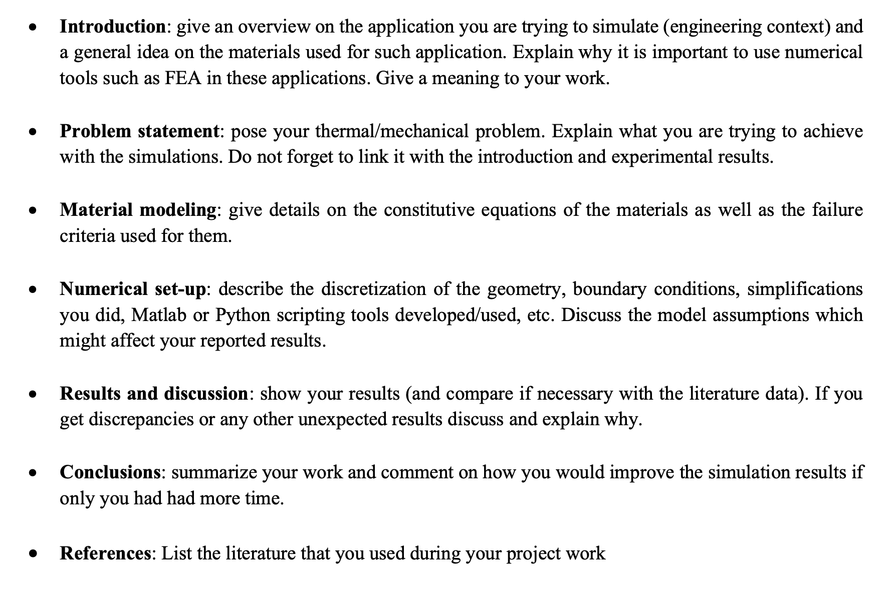

Slide 2

Dynamic Behavior of Materials Group I: Fuselage Impact
Aris Dimitracopoulos
Salvatore Palumbo
Julien Purificato
Jay Shah
Manfredi Tambella
24.01.2024, Zürich

Slide 3
Agenda
Introduction
Problem statement
Material modeling
Numerical set-up
Results & Discussion
Conclusions
References

Slide 4
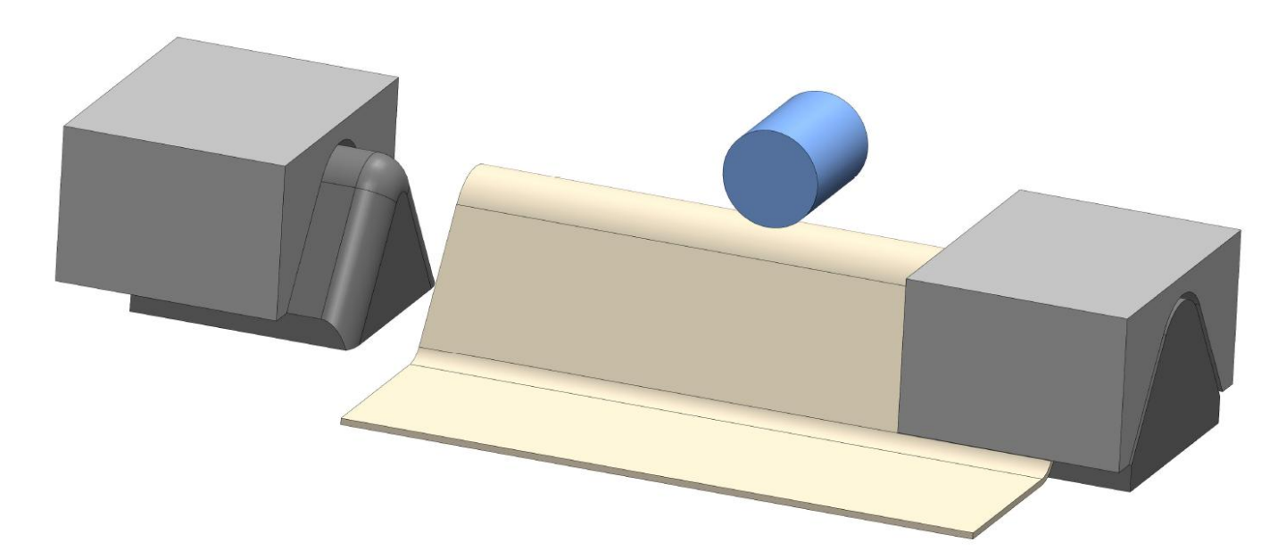
1. Introduction
The study is about assessing material performance under impact condition from the foreign object.
This study focuses on the cover of an aircraft component (eg. a FLAP), which is supposed to be critical for flight control and for this reason its integrity must be protected.
Two types of materials are under analysis for this application.[2][3]
The flap is subjected to impacts from heavy projectiles (MARS300 [1]), requiring materials and geometry to sustain these conditions.
Notes:
Jay

Slide 5
2. Problem Assessment
The goal of the project lies in the efficient simulation of impact with various cut-outs, as well as the assessment of loading histories.
Analyze trends in plastic deformation and fracture behavior.
There are various parameters on which the study has been conducted. Namely: Impact Velocity, Cap Radius, Bend Angle, Central Section Width, Material, thickness, and clamping conditions.
Since there are a number of parameters, automation of the simulations is very important for the study and therefore a scripting procedure has been chosen.
Notes:
Efficient simulations consists of everything(preprocess, execution, and postprocess)

Slide 6
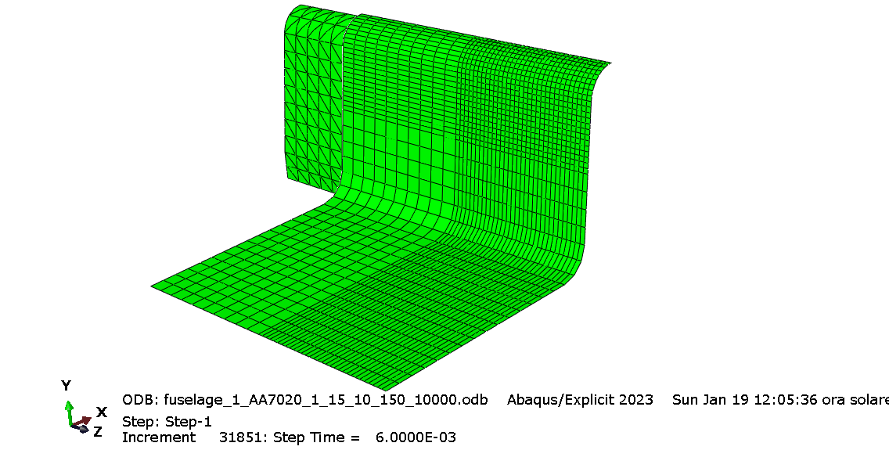
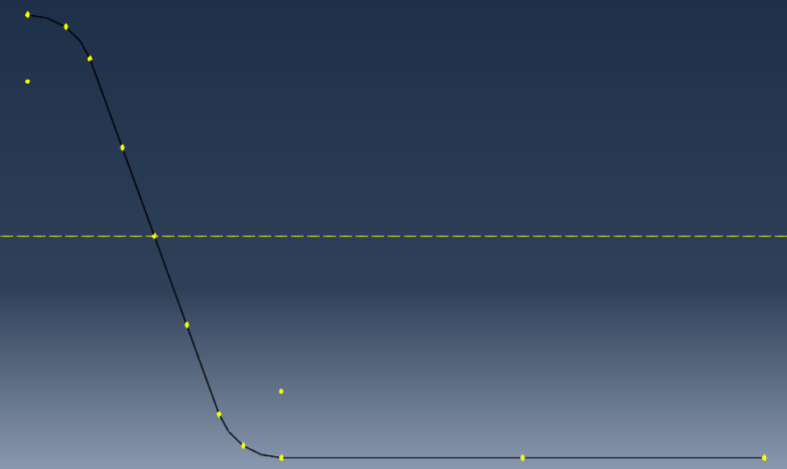
2. Problem Assessment
Approach:
Parametric study of the geometry to get the trends in terms of dissipated energy.
Stress state analysis in fractured elements.
4-fold symmetry.
Central Section Width
Cap Radius
Bend Angle/2
Notes:
Jay

Slide 7
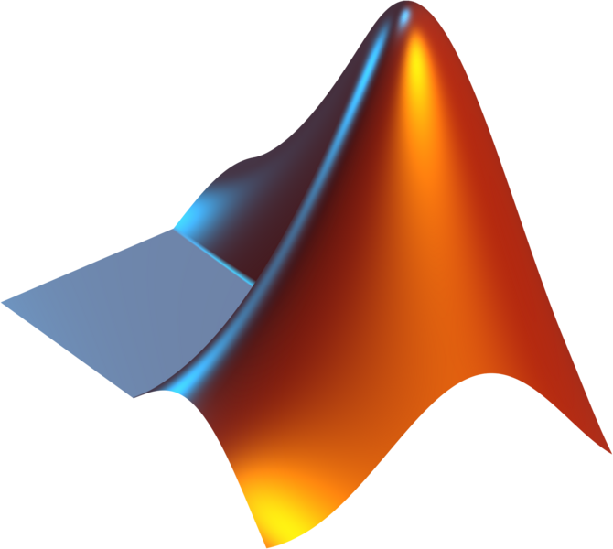


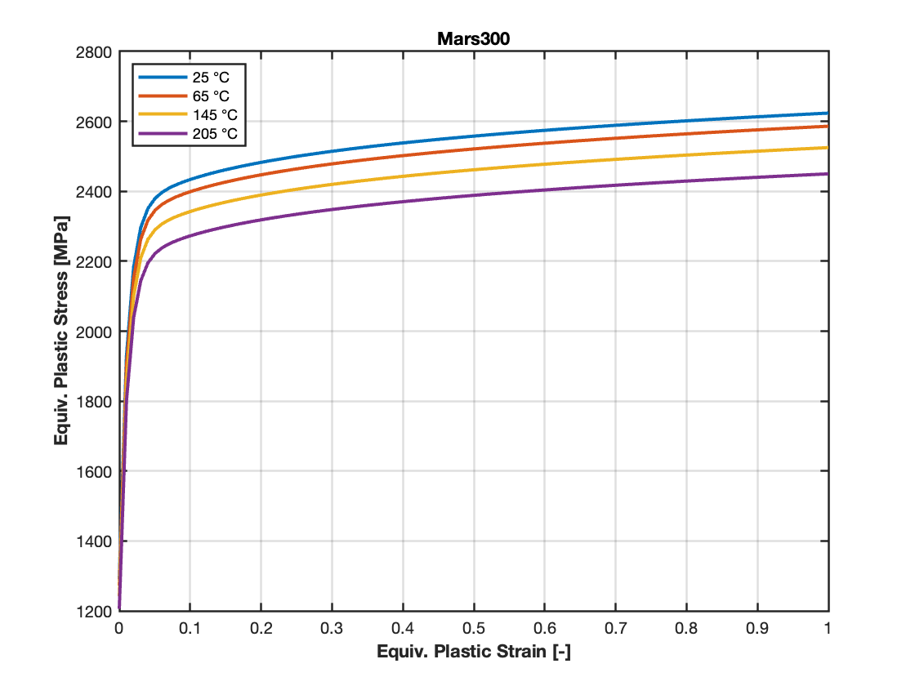
3. Material Modeling
Impactor material
E [MPa] | Density [t/mm^3] | Poisson Ratio | A [MPa] | e0 | n | k0 [MPa]
200000 | 7,85E-09 | 0,3 | 4439,57 | 0,000513 | 0,184 | 1318,14
185000 | 7,85E-09 | 0,33 | 1526,5 | 0,00519 | 0,242 | 488,91
74000 | 2,78E-09 | 0,33 | 897,35 | 0,0127 | 0,2469 | 331,013
Q [MPa] | Beta | Alpha | de0 [1/s] | C | m | Tr [°C]
1048,44 | 86,48 | 0,124 | 0,001 | 0,00188 | 1,394 | 25
447,5 | 18,65 | 0,536 | 0,00321 | 0,00557 | 1,025 | 20
320,979 | 9,255 | 0,146 | 0 | 0 | 1,7054 | 25
Tm [°C] | Cp [J/kg·K] | a | b | c | d | nf
1287 | 449 | 1,349 | 0,3254 | 0,0755 | 0,0494 | 0,1
1533,7 | 420 | 1,22 | 1,27 | 0,11 | 0,066 | 0,1
337 | 897 | 1,25 | 0,61 | 0,04 | 0 | 0,1
Mars300
TRIP780
AA7020-T60
Notes:
Manfredi

Slide 8
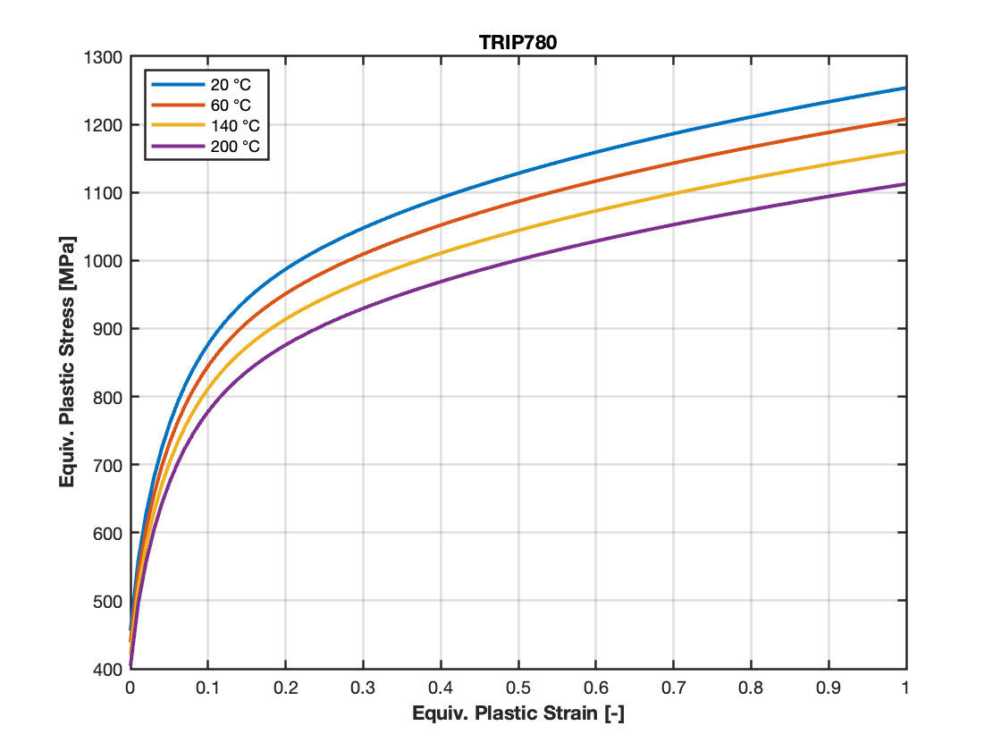
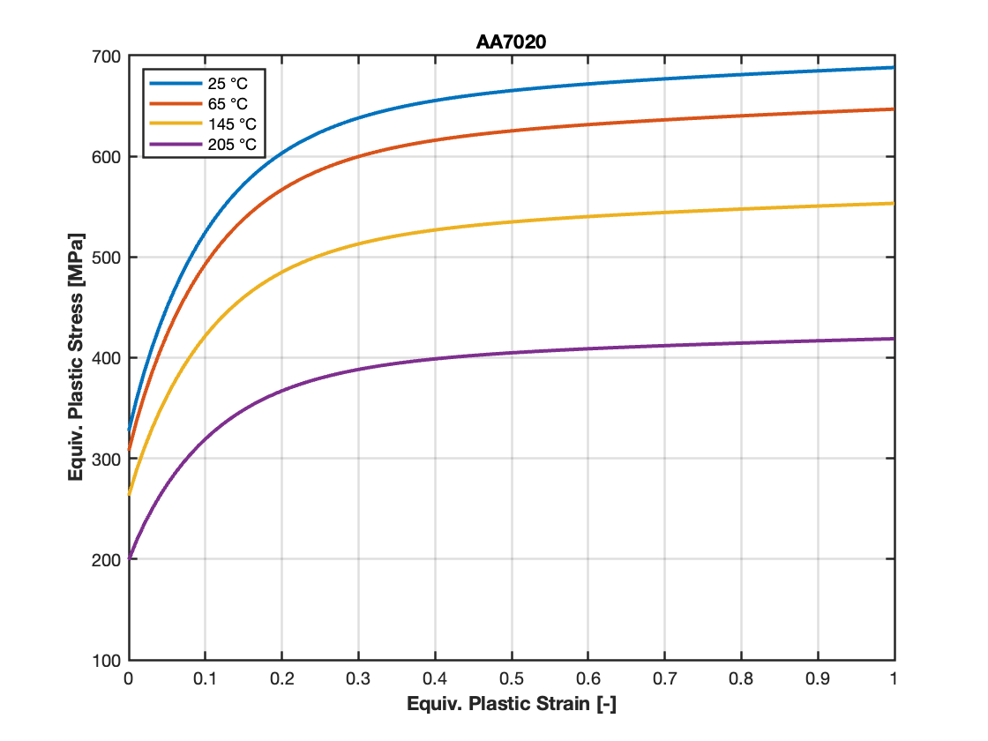
3. True stress - true strain curves, fuselage materials
Mixed Swift-Voce
Johnson-Cook temperature softening particularly pronounced for AA7020
Notes:
Manfredi

Slide 9
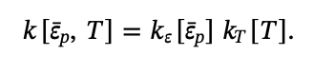
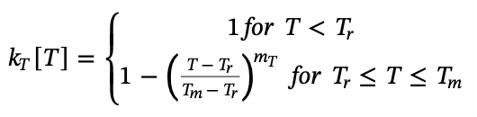
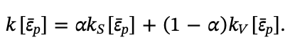
3. Mixed Swift-Voce, constitutive equations
Temperature range: 20-200 °C, for all materials
Notes:
Manfredi

Slide 10
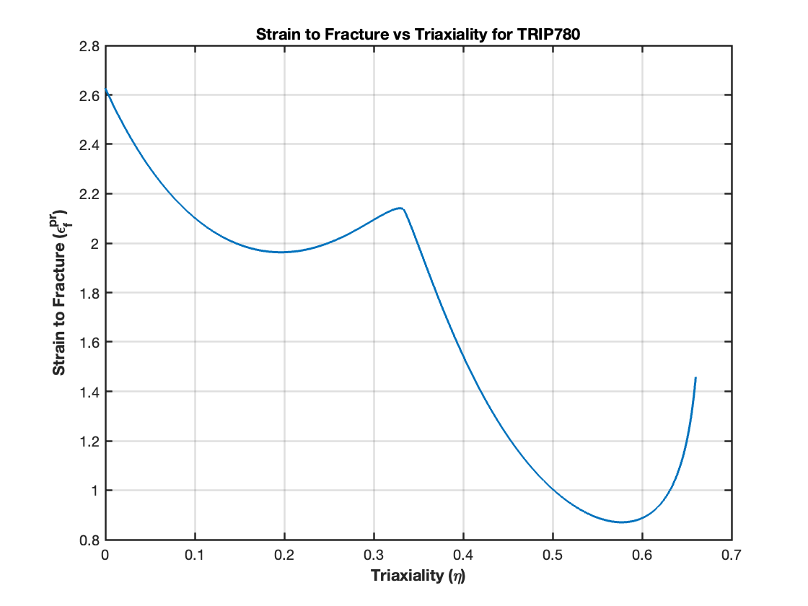
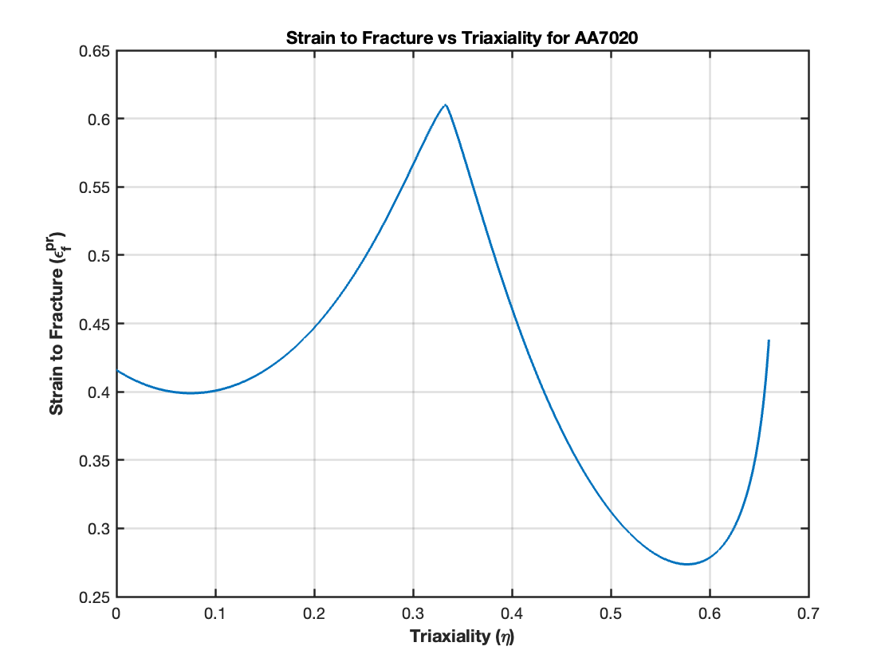
3. Hosford-Coulomb fracture model, fuselage materials
100/s
Plane stress assumption -> 2D space
Pronounced difference in ductility for axisymmetric stress states
Notes:
Manfredi

Slide 11
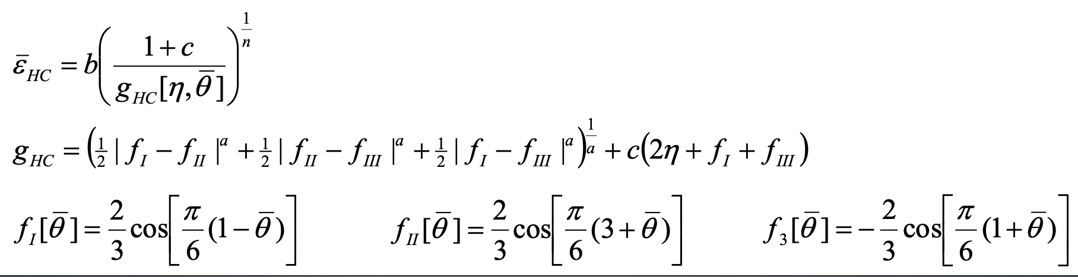
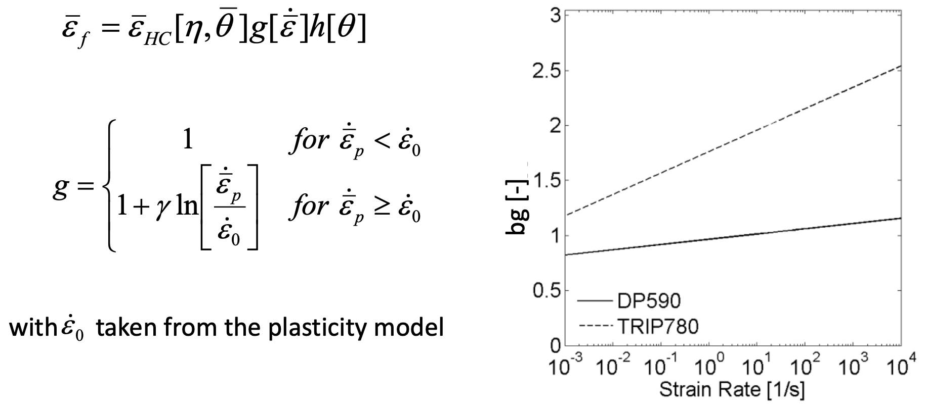
3. H-C fracture, constitutive equations
Notes:
Manfredi

Slide 12
4. Numerical Setup (aimed to the parametric study)

Slide 13
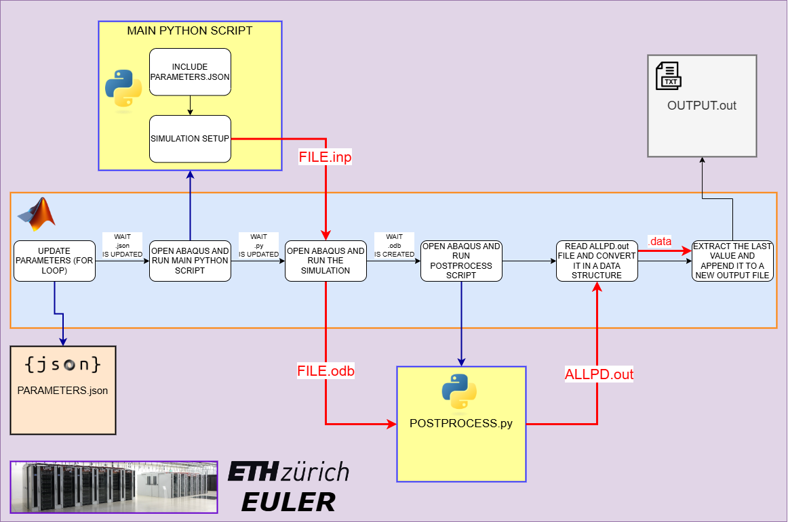
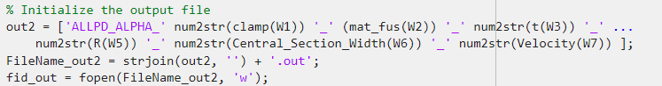
Notes:
Salvatore

Slide 14
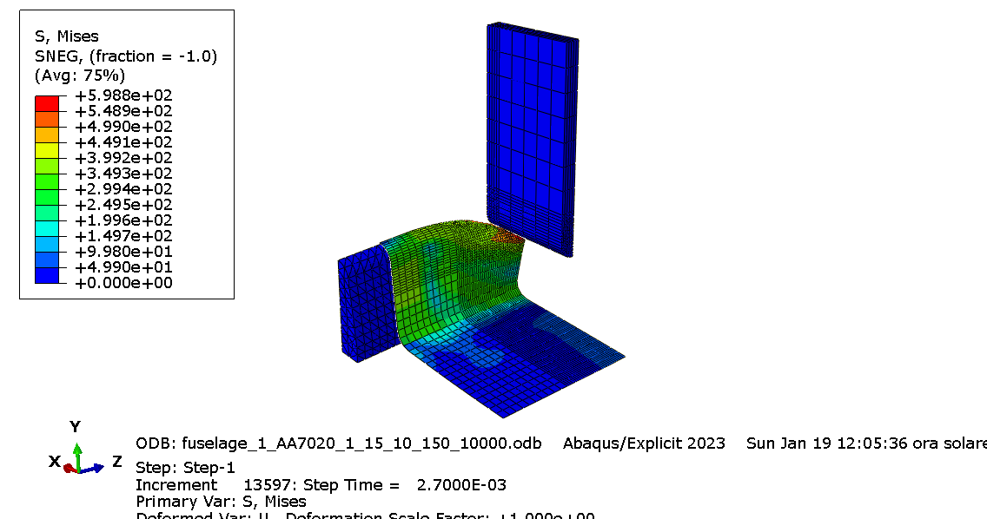
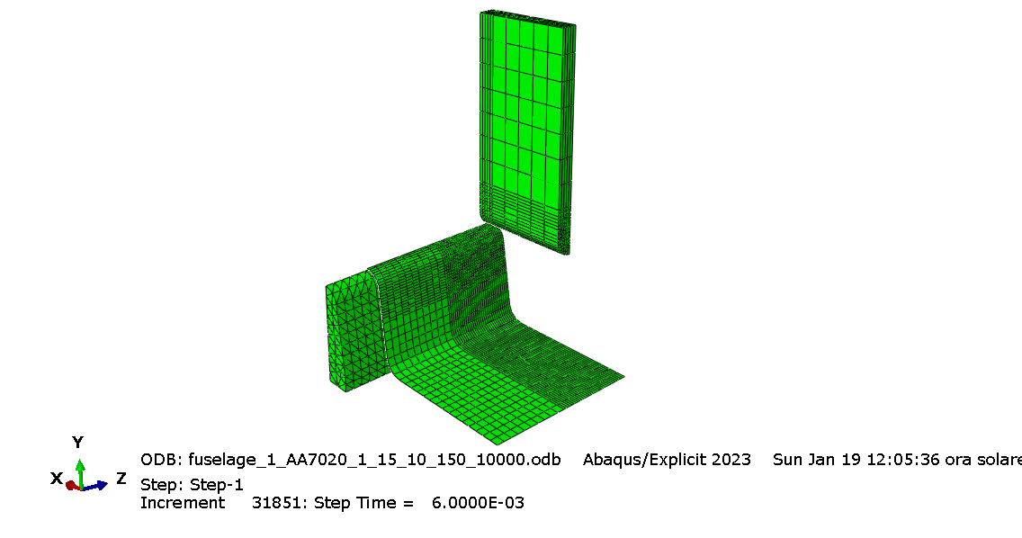
4.1. Simulation Setup (Main Python Script)
Notes:
Aris

Slide 15
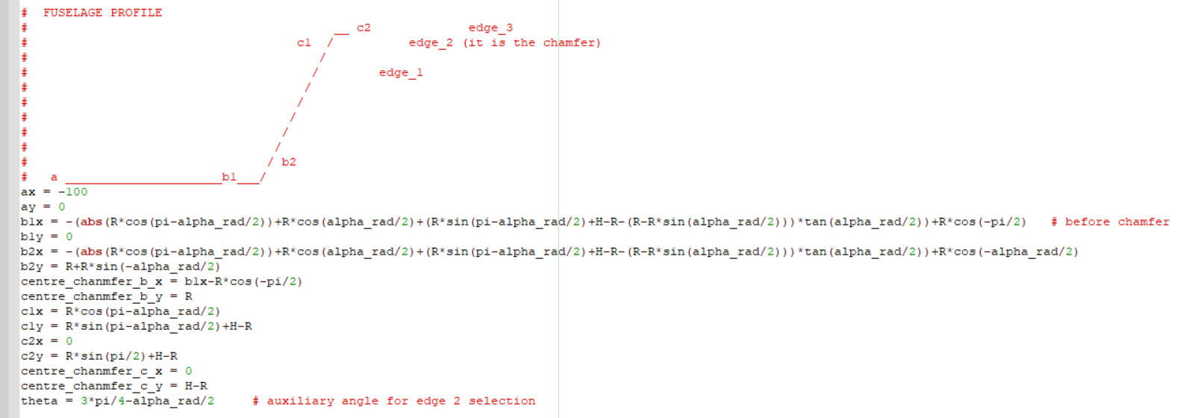
4.1. Simulation Setup (Main Python Script)
Parametric approach
Notes:
Aris

Slide 16
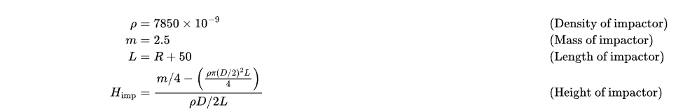
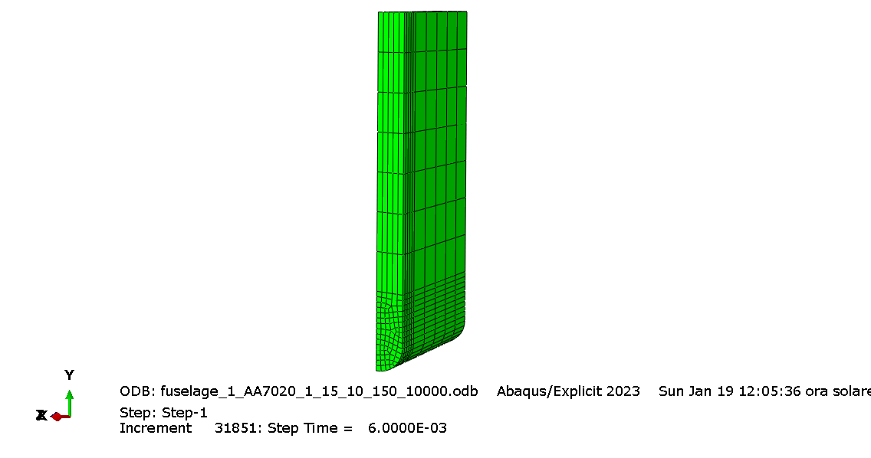
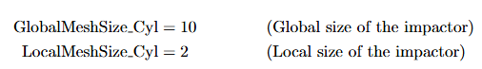
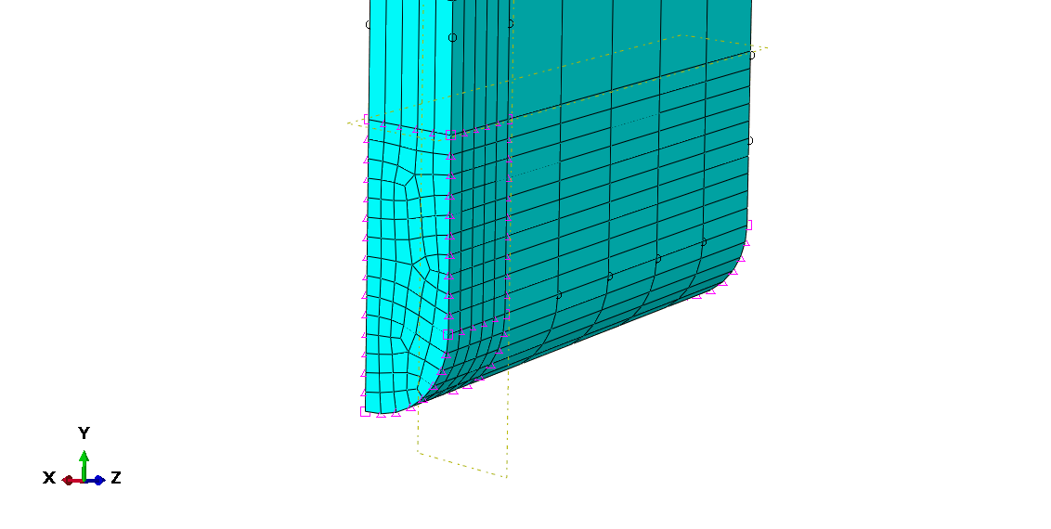
4.1.1. Impactor Geometry
MARS300
Refined mesh
Notes:
Salvatore

Slide 17
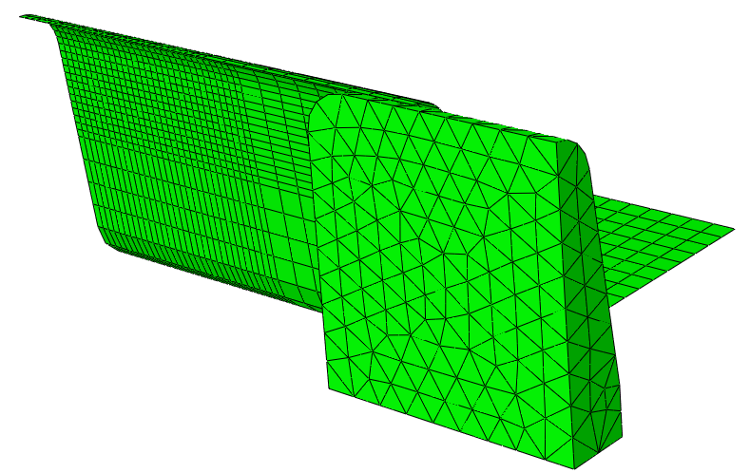
4.1.2. Fuselage and Support Geometry
Notes:
Aris

Slide 18
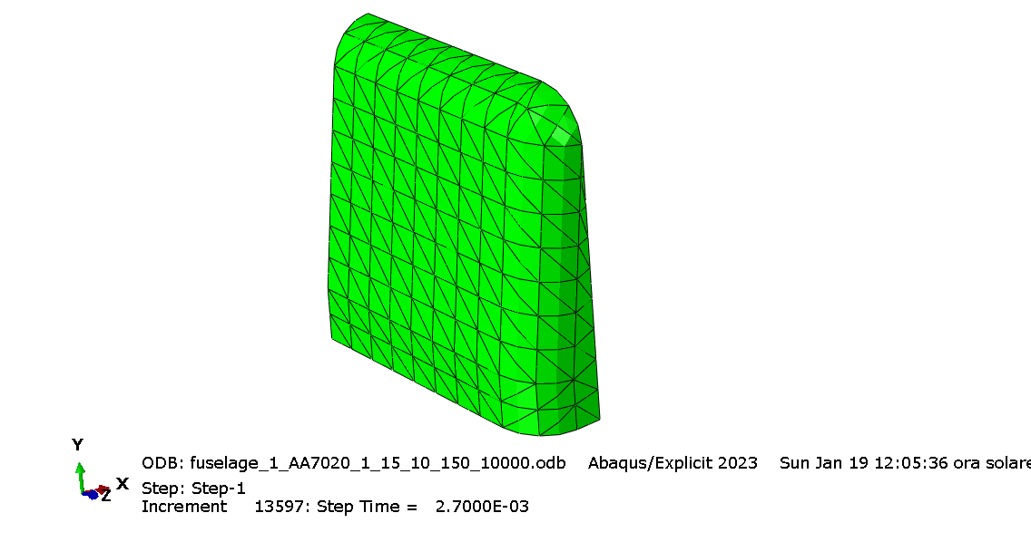
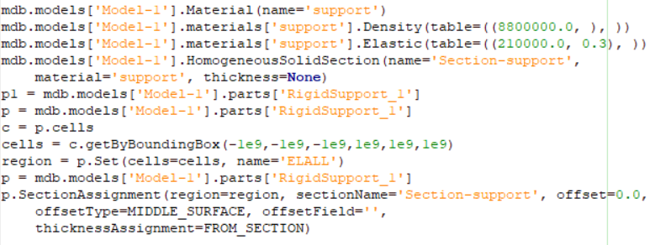
4.1.2. Fuselage and Support Geometry
No Refined Mesh
No Plasticity, No Fracture model
Notes:
Aris

Slide 19
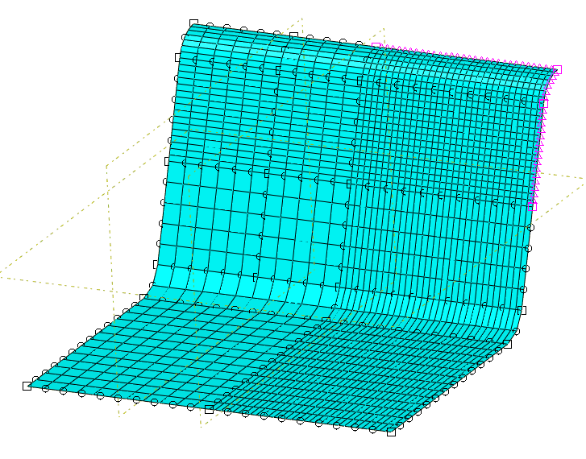
4.1.2. Fuselage and Support Geometry
Cap Radius
AA7020|TRIP780
Clamped region
Central Section Width
Cap Radius
Bend Angle/2
2 FIXED DATUM PLANE
Refined mesh
Notes:
Julien / Mention type of mesh

Slide 20
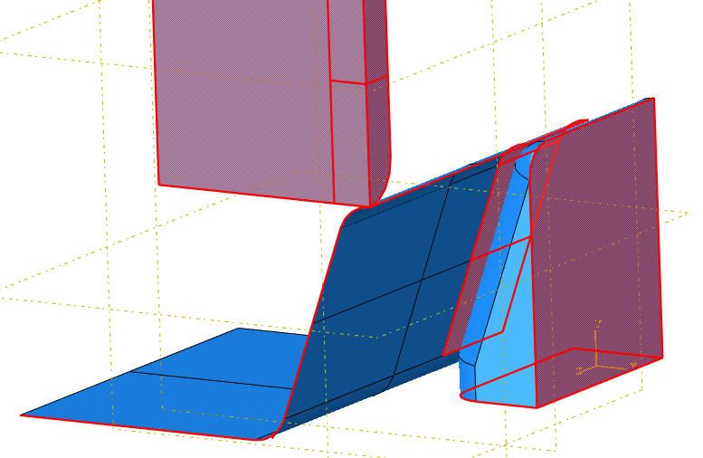
4.2. Boundary conditions (Main Python Script)
Impactor:
Symmetries: ZMAX, XMAX
Predefined Field: Velocity = 10 m/s
Predefined Field: Temperature = 25°C
XMAX
ZMAX
XMAX
Fuselage:
Symmetries: ZMAX, XMAX
DisplacementBC: All displacements and Rotations are fixed except u3 (width direction)
Predefined Field: Temperature = 25°C
ZMAX
Rigid Support:
Symmetries: XMIN
Encastre: YMIN
XMIN
YMIN
Notes:
Salvatore

Slide 21
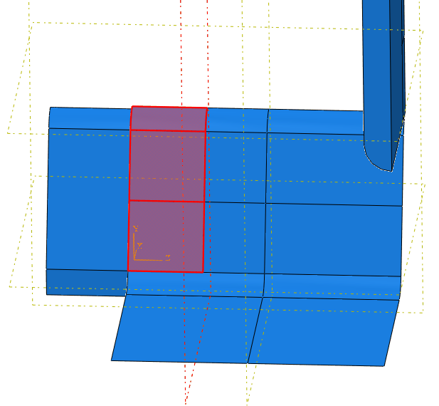
4.2.1. Clamping Simplification
Clamping is a Displacement BC
Moving DATUM PLANE
Notes:
Salvatore

Slide 22
4.2.1. Clamping Simplification
Clamping is a Displacement BC
Moving DATUM PLANE
Due to the presence of the FIXED DATUM PLANE, new edges and faces are created when the datum plane moves (due to the changing of the CENTRAL SECTION WIDTH). So the faces PICKED for the creation of the CLAMP SET change according to the value of the CENTRAL SECTION WIDTH.
As a consequence also the meshing of the fuselage has been rearranged.
Notes:
Salvatore

Slide 23
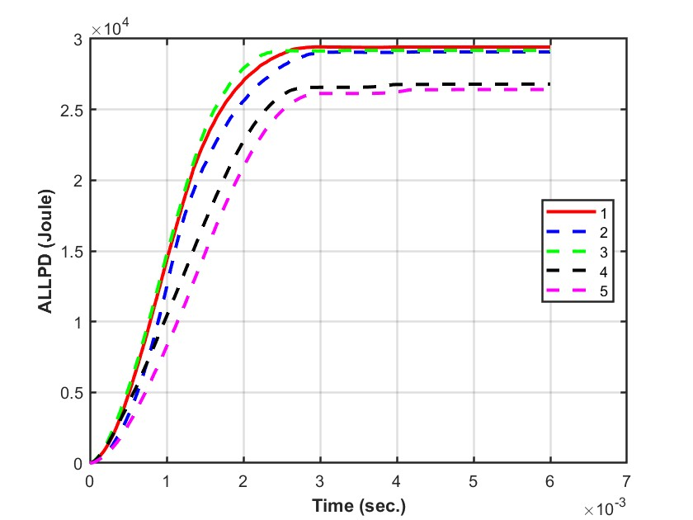
4.3. Mesh size convergence study
Selection of Geometry for mesh convergence study
Among the 5 configurations, set 1 dissipates maximum inelastic energy, we therefore chose “Set 1” as the configuration for mesh study. (Set 1: α = 15°, r = 5mm, Central Section width = 50mm).
Notes:
ALLPD = Inelastic energy dissipation of the fuselage

Slide 24
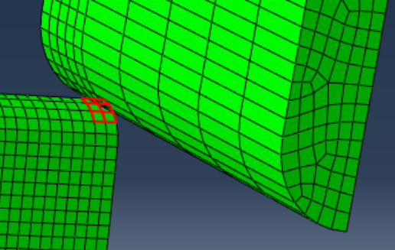
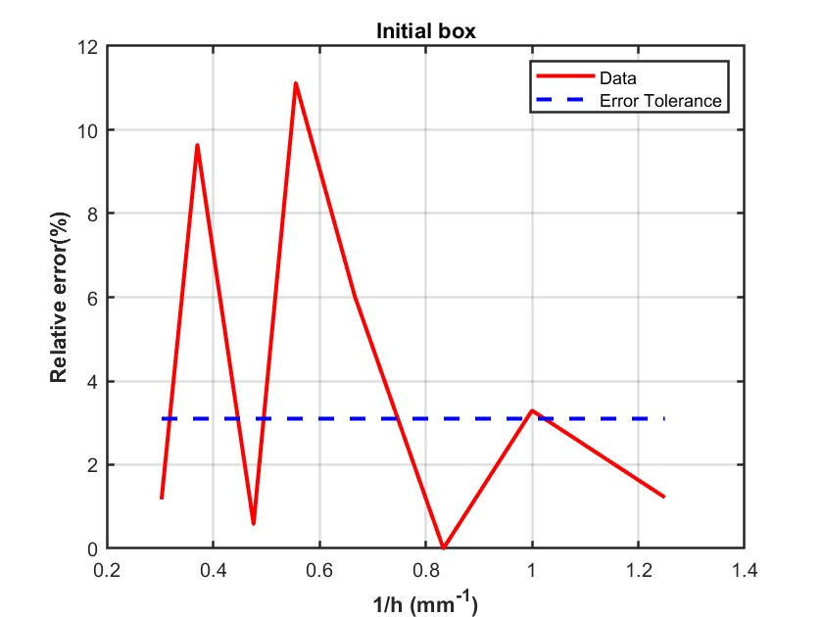
4.3. Mesh size convergence study
Initial Box for Mesh Size of 2.1 mm
Notes:
We defined a box of elements changing with the mesh size and extracted the average PEEQ value of the box and plotted the relative error of this average PEEQ against the mesh size inverse. This result also doesn’t satisfy us as we get a peak in the middle of the graph which is undesirable. We found element deletion of the box elements in a line that are directly under the impactor. This would not give us the correct average PEEQ values. So we had to shift the box.

Slide 25
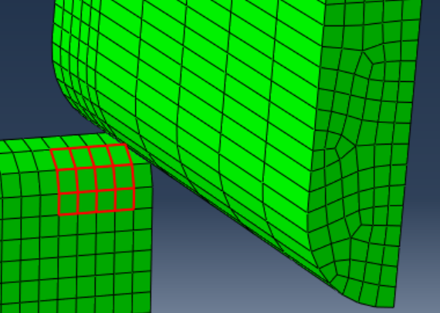
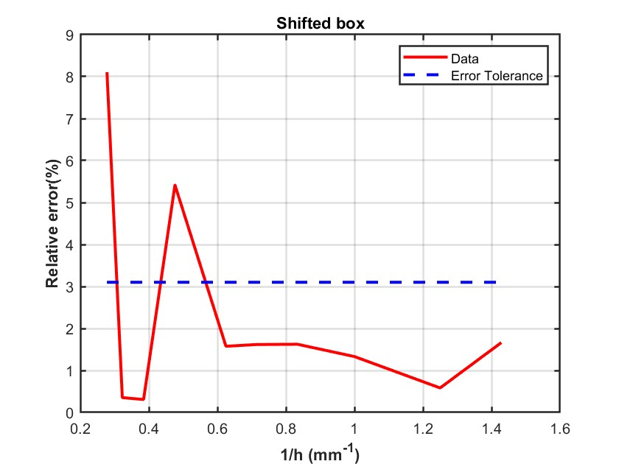
4.3. Mesh size convergence study
Shifted Box for Mesh Size of 2.1 mm
h = 1.6mm
Notes:
After shift, there is no deletion of elements and not peak in the middle. Therefore this result is satisfactory and therefore we went h = 1.6mm.

Slide 26
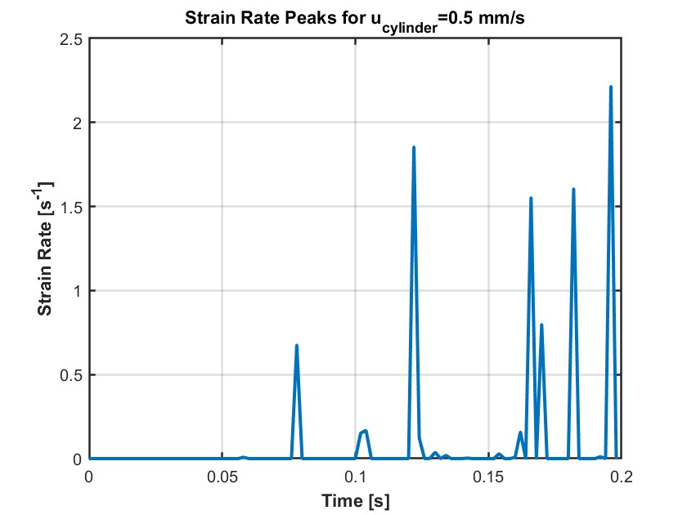
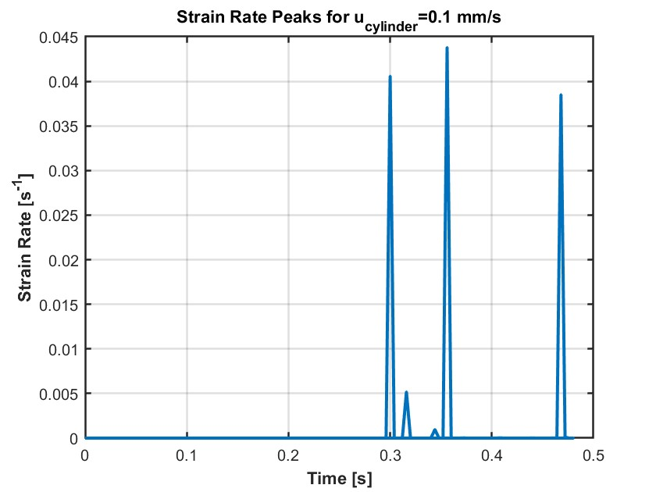
4.4. Defining the Quasi-Static Velocity
Notes:
Julien / Mention what change in the quasi-static (velocity is bc)

Slide 27
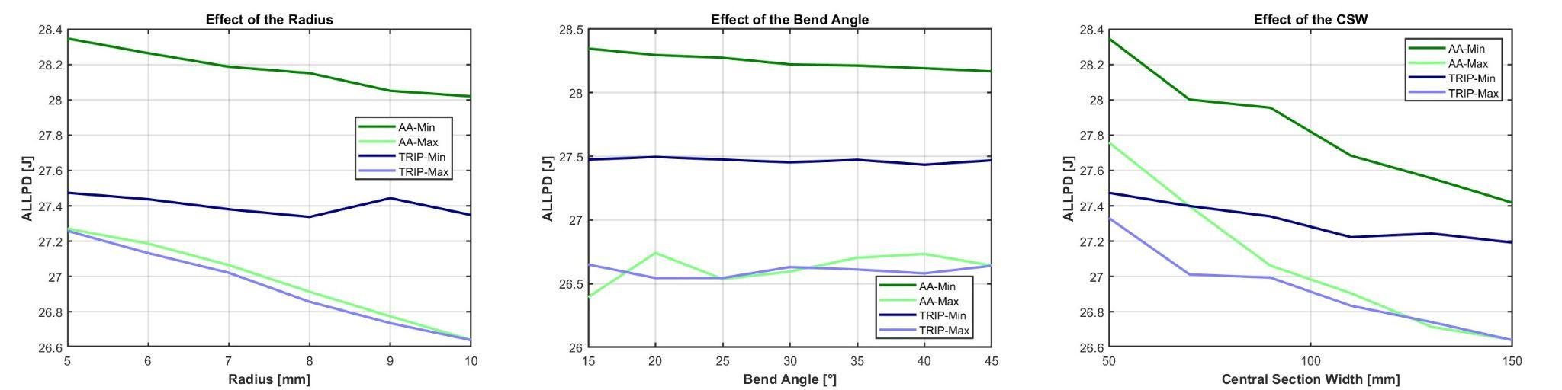
5.1. Parametric Study with Impact Conditions and Free BC
Min and Max refer to cases where, for a given material and parametric variable, the other two variables are at their minimum and maximum values respectively.
Notes:
Julien / Draw observations from the graphs

Slide 28
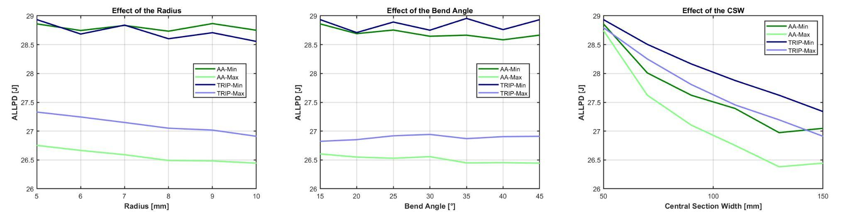
5.2. Parametric Study with Impact Conditions and Clamped BC
Min and Max refer to cases where, for a given material and parametric variable, the other two variables are at their minimum and maximum values respectively.
Notes:
Julien / Draw observations from the graphs

Slide 29
5.3. Parametric Study with Quasi-Static Conditions and Clamped BC
Modified parameters for the quasi-static simulations:
Predefined velocity field is removed and replaced by a velocity boundary condition (0.1 mm/sec)
Adiabatic effects are kept on
Mass scaling is used to decrease computational effort (target increment 0.05 sec)
We want to compare the Von Mises stress at the highest element of the fuselage for impact and quasi-static simulations:
Find the maximum Von Mises stress in the impact case and corresponding PEEQ
Find the Von Mises stress in the quasi-static case corresponding to the same PEEQ value as in the dynamic simulation
Compare Von Mises stress
Notes:
Aris

Slide 30
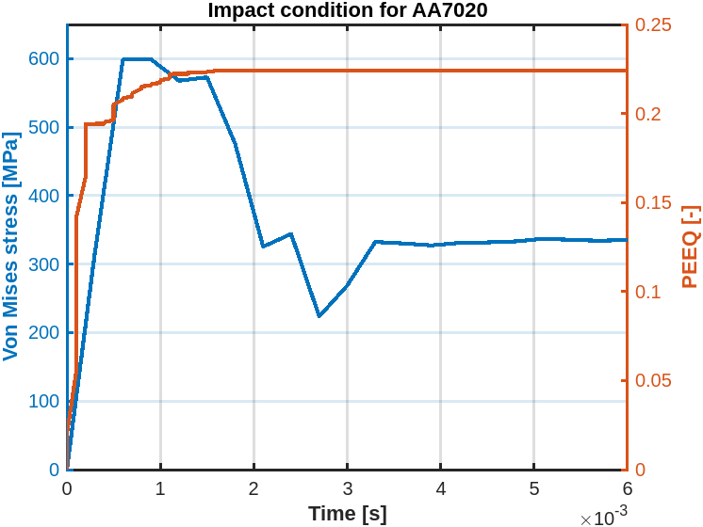
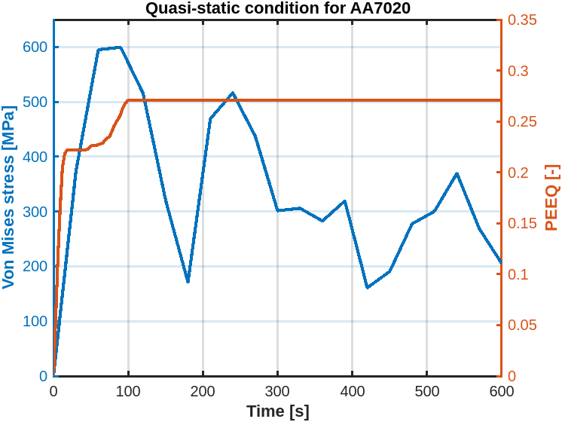
5.3. Parametric Study with Quasi-Static Conditions and Clamped BC
Max Von Mises: 599 MPa
PEEQ: 0.2166
PEEQ: 0.2166
Von Mises: 599 MPa
Notes:
Aris

Slide 31
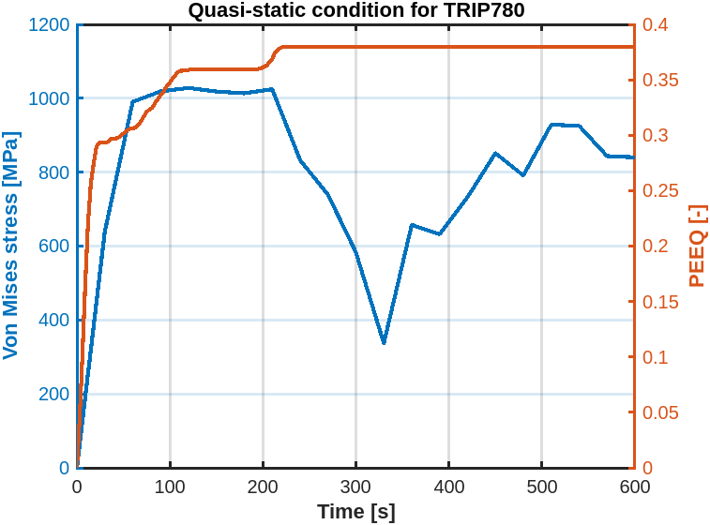
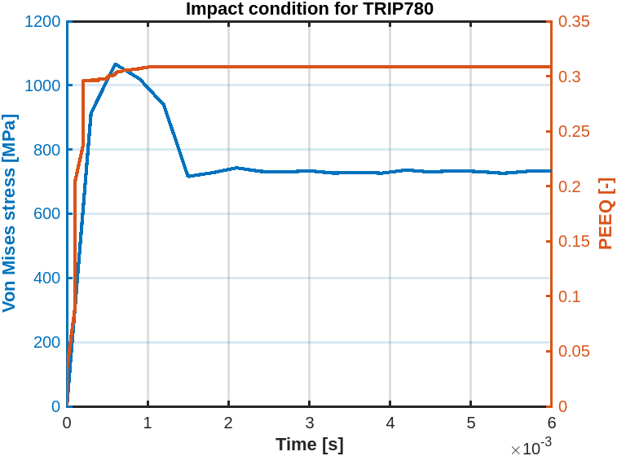
5.3. Parametric Study with Quasi-Static Conditions and Clamped BC
Max Von Mises: 1066 MPa
PEEQ: 0.3022
PEEQ: 0.3022
Von Mises: 900 MPa
Notes:
Aris

Slide 32
5.3. Parametric Study with Quasi-Static Conditions and Clamped BC
Discussion of results:
As expected, for the same PEEQ, the Von Mises stress is the same for AA7020 (non-rate dependant) and different for TRIP780 (rate dependant)
Fracture occurs after 200 sec for TRIP780 but after 100 sec for AA7020 when small strain rate are applied
TRIP780 might be preferred in a case of quasi-static strain rates for the selected geometry (alpha = 15 deg , cap radius = 5 mm , central section width = 50 mm)
Note that the kinetic energy was less than 5% of the total internal energy in the system, meaning that the simulations can indeed be considered quasi-static.
Notes:
Aris

Slide 33
5.4. Fracture investigation
TRIP780 shows no fracture in any of the tested configurations
AA7020: central section width has high importance in fracture development
Dependence on cap radius & bend angle in fracture behavior
Notes:
Manfredi

Slide 34
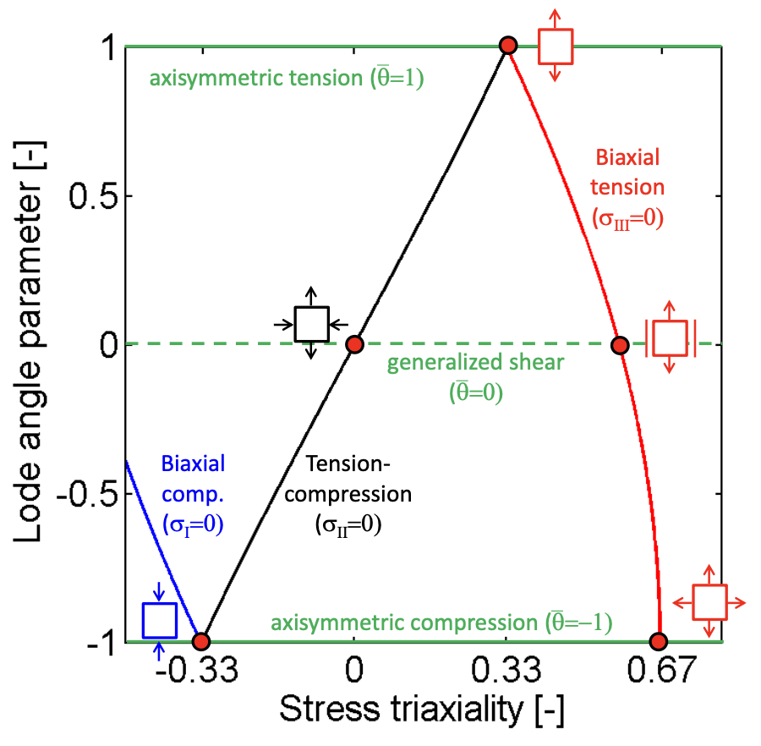
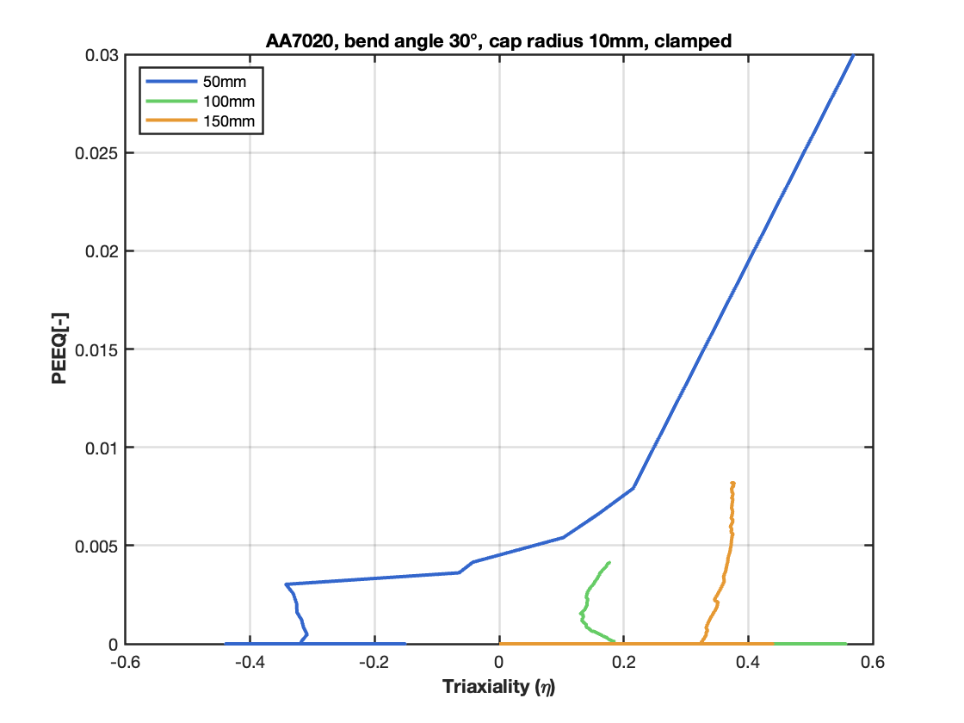
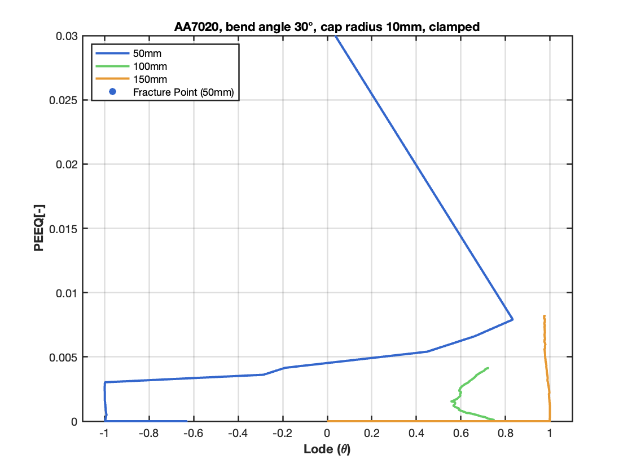
5.4. Central width
Values were extracted for shell elements SPOS.
Notes:
Manfredi

Slide 35
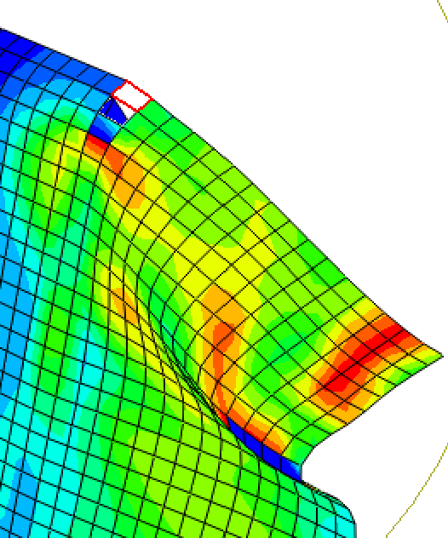
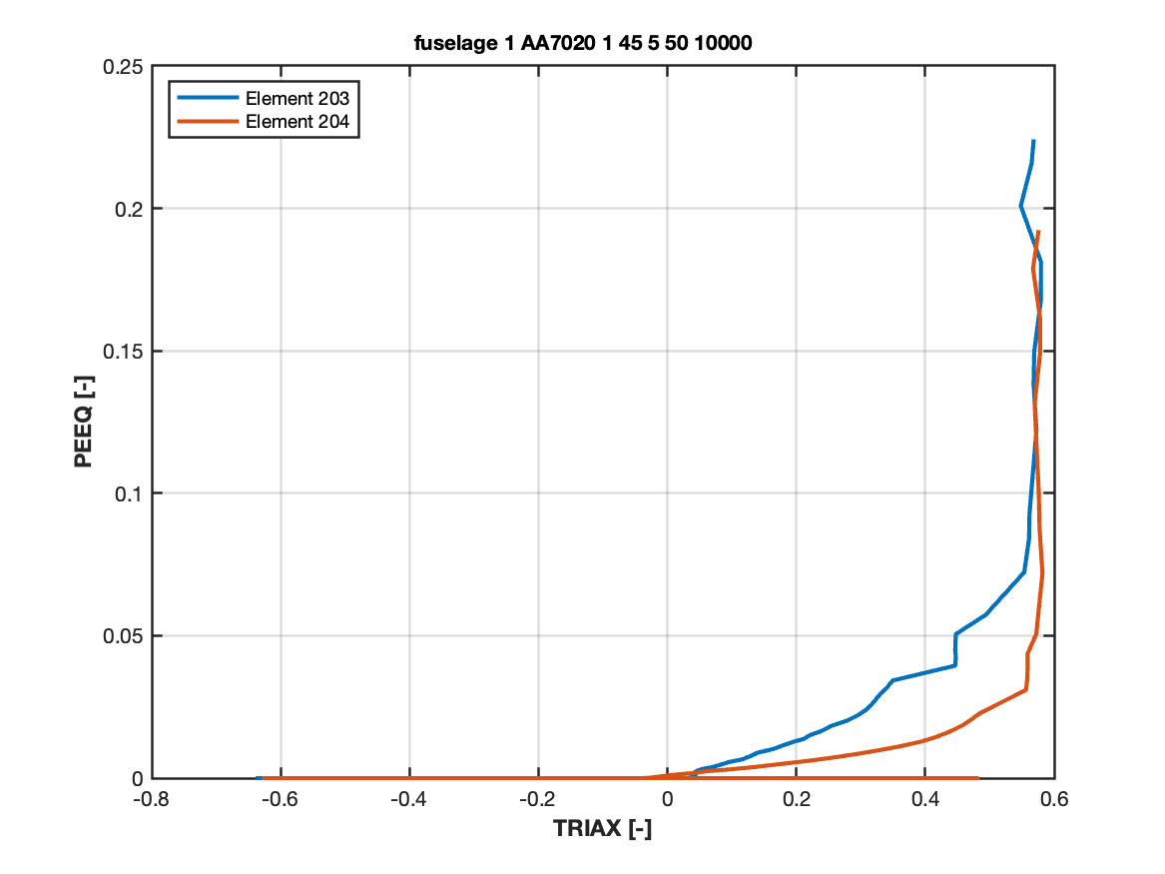
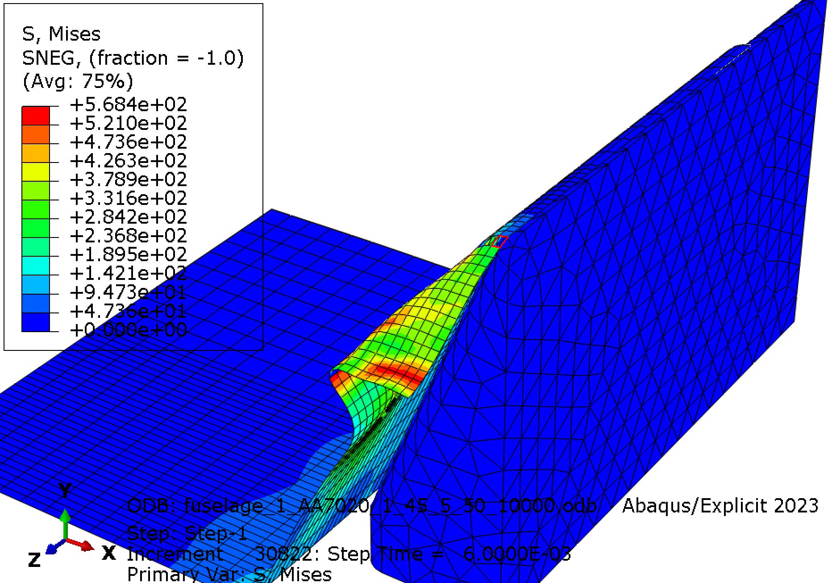
5.4. Status identification
Status checked from last frame, code of fractured element, history output extracted for PEEQ, TRIAX, LODE at specific location.
Notes:
Manfredi

Slide 36
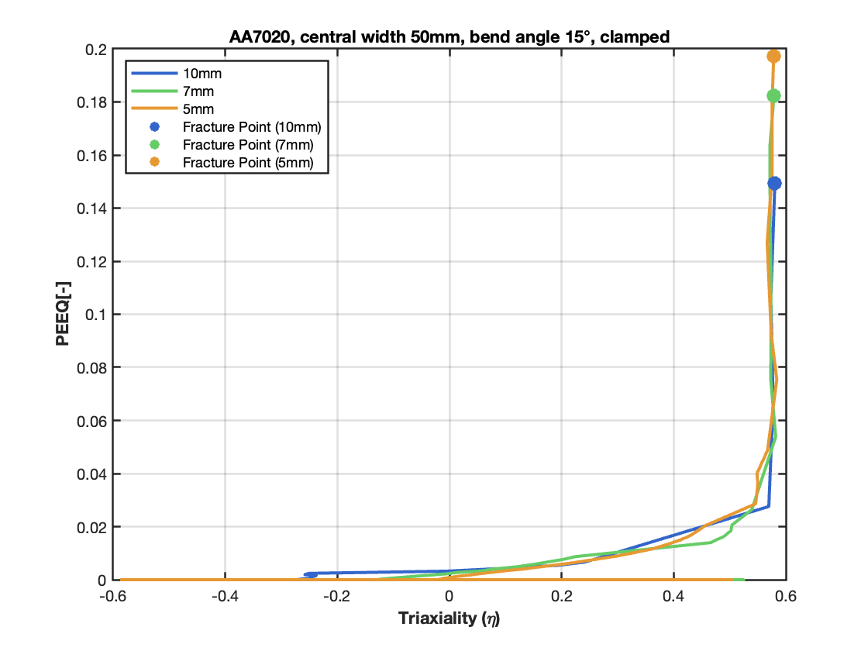

5.4. Cap Radius
Strain to fracture of 5 mm configuration is 8.3% higher than 7 mm, 32% higher than 10 mm.
Notes:
Manfredi

Slide 37


5.4. Bend Angle
Strain to fracture of 45° configuration is 4.5% higher than 30°, 2.9% higher than 15°.
Notes:
Manfredi

Slide 38
6. Conclusion
Learnt Automatic CAE Simulation
AA7020 material absorbs more energy but leads to fracture
Bend Angle has almost no effect on the ALLPD in contrast to Radius and Central Section Width
Clamping is important for Min configurations
Strain rate dependency is important for different velocities
Cap radius highly affects PEEQ at fracture

Slide 39
7. References:
[1] Fras T, Roth CC, Mohr D. (2018). Fracture of high-strength armor steel under impact loading. International Journal of Impact Engineering 111: 147-64. https://doi.org/10.1016/j.ijimpeng.2017.09.009
[2] Roth, C.C., Mohr, D. (2014). Effect of strain rate on ductile fracture initiation in advanced high strength steel sheets: experiments and modeling. International Journal of Plasticity, 56 pp. 19–44 https://doi.org/10.1016/j.ijplas.2014.01.003
[3] Roth, C.C., Fras, T., Mohr, D., 2020. Dynamic perforation of lightweight armor: Temperature-dependent plasticity and fracture of aluminum 7020-T6. Mech. Mater. 149, 103537. https://doi.org/10.1016/j.mechmat.2020.103537

Slide 40
THANK YOU
for your attention

